Slide 1


Team Details
  Team name: R4131N
  Team leader name: Isak Rabin
  Problem Statement: KiasuCheck - Same Shop. Same Product. Why Pay More? AI-Powered Cross-Platform Price Transparency.

Slide 2
KiasuCheck: AI-Powered Cross-Platform Price Intelligence
Same shop. Same product. Different prices across platforms.
Don’t lose out. Check before you buy.
PROBLEM
THE PRICE GAP
Cross-platform price differences
One seller. Multiple platforms. Different prices?
The same seller may charge different prices across platforms, hidden behind different shop names and product listings.
The same merchant can list identical products at different prices across shopping platforms without shoppers easily recognising the differences.
KiasuCheck uses AI to identify the same seller and product across shopping platforms, reveal price differences and support informed buying decisions.
SOLUTION
AI-powered price transparency
AI identifies the same seller and product across platforms, compares available prices and shows supporting evidence.

Slide 3
The Opportunity: Cross-Platform Price Transparency
Why the Same Merchant Can Have Different Prices
REALITY 01
REALITY 02
REALITY 03
One seller, many storefronts
Same product, different prices
Difficult to compare
Merchants may sell across platforms under the same store name or different identities.
The same merchant may list identical products at different prices on different platforms.
Different product titles, vouchers and shipping fees make the real price gap difficult to identify.
UNIQUE SELLING PROPOSITION
Beyond price comparison: reveal hidden price differences across a seller’s storefronts.

Slide 4
From a Product Listing to a Verified Price Comparison
Four capabilities turn fragmented listings into evidence-backed price transparency.
01 · SEE
02 · SEARCH
03 · VERIFY
04 · EXPLAIN
Multimodal input
Grounded discovery
Seller + product identity
Price difference + proof
Screenshot, URL or product name.
Public Shopee, Lazada, TikTok Shop and retailers.
Match the merchant and exact product variant; flag uncertainty.
Platform prices, sources, uncertainty and potential savings.
AI proposes evidence. The shopper decides.

Slide 5
How KiasuCheck Investigates a Price Difference
An iterative AI investigation: identify, search, verify and compare.
01 · OBSERVE
02 · PLAN
03 · SEARCH
04 · VERIFY
Screenshot / URL
Identify shop + SKU
Grounded web
Compare verified offers
Read messy marketplace context.
Find seller aliases and the product's key attributes.
Gather public evidence.
Exclude mismatches; calculate comparable price differences.
HUMAN DECISION
Review sources · confirm checkout price · choose platform

Slide 6
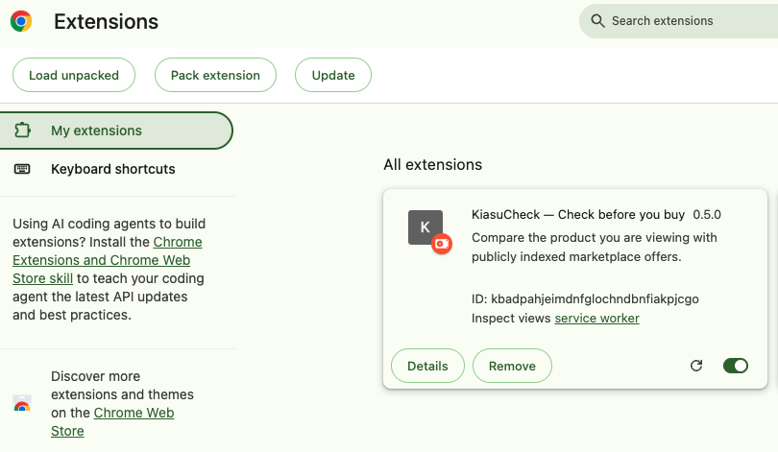
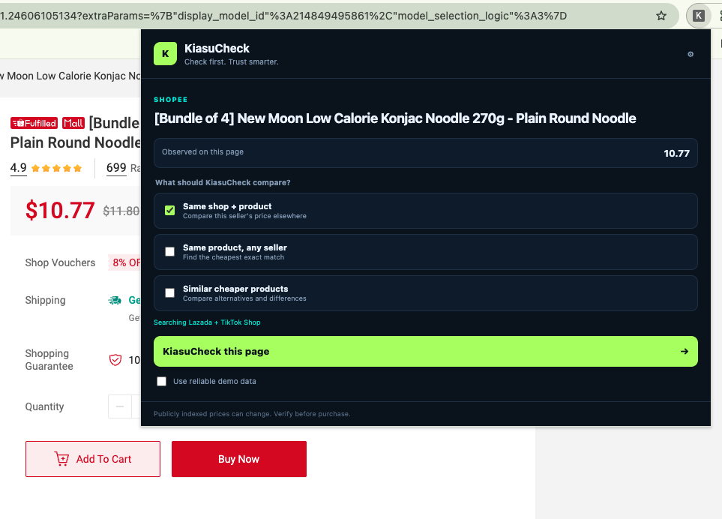
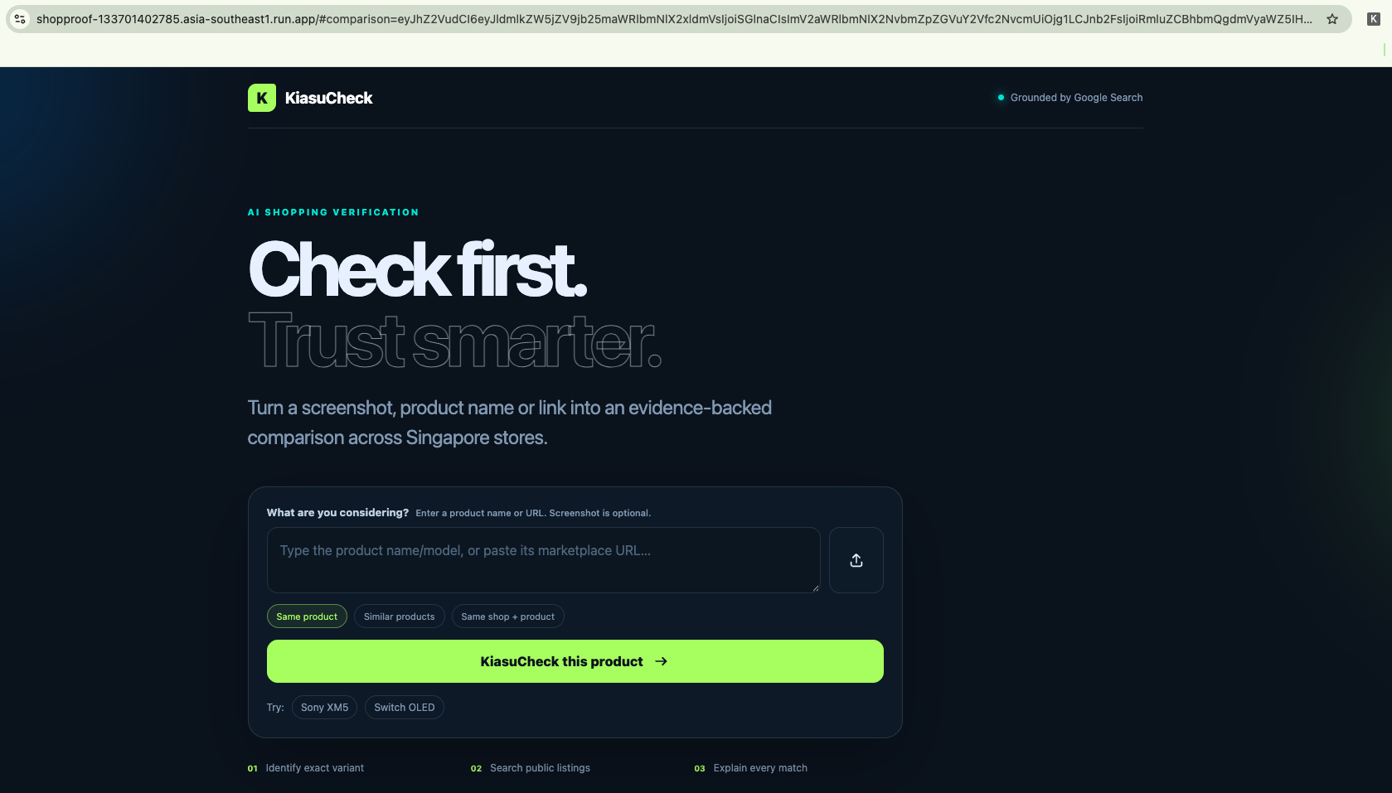
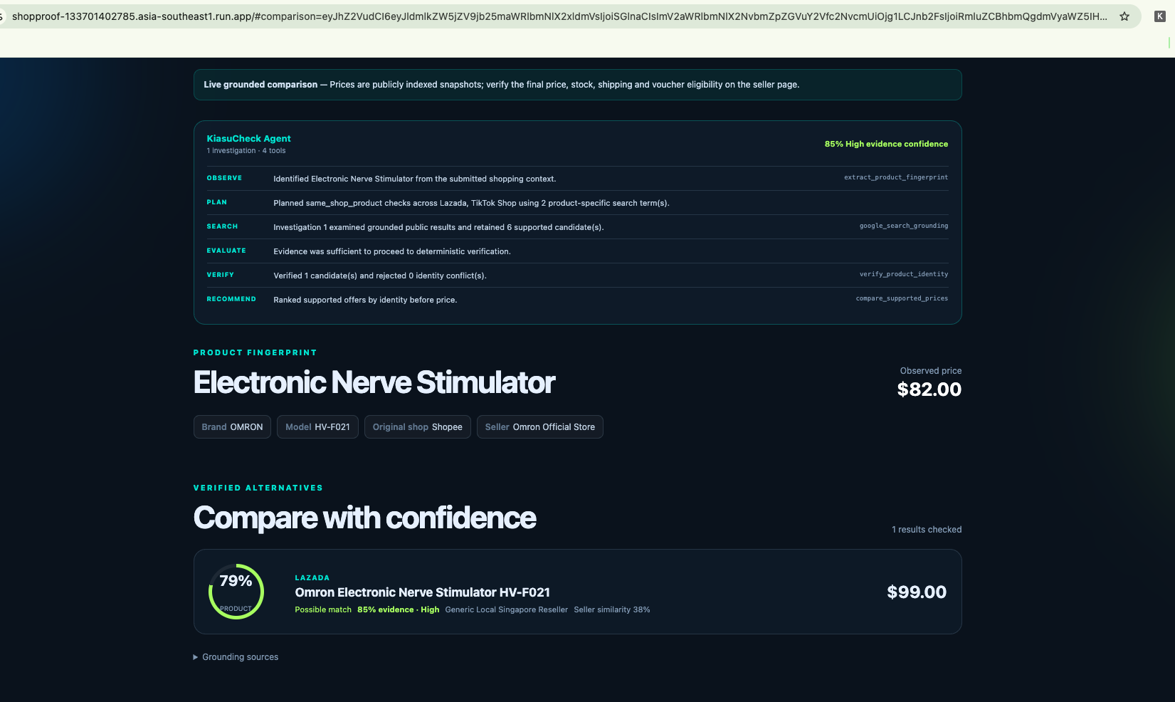
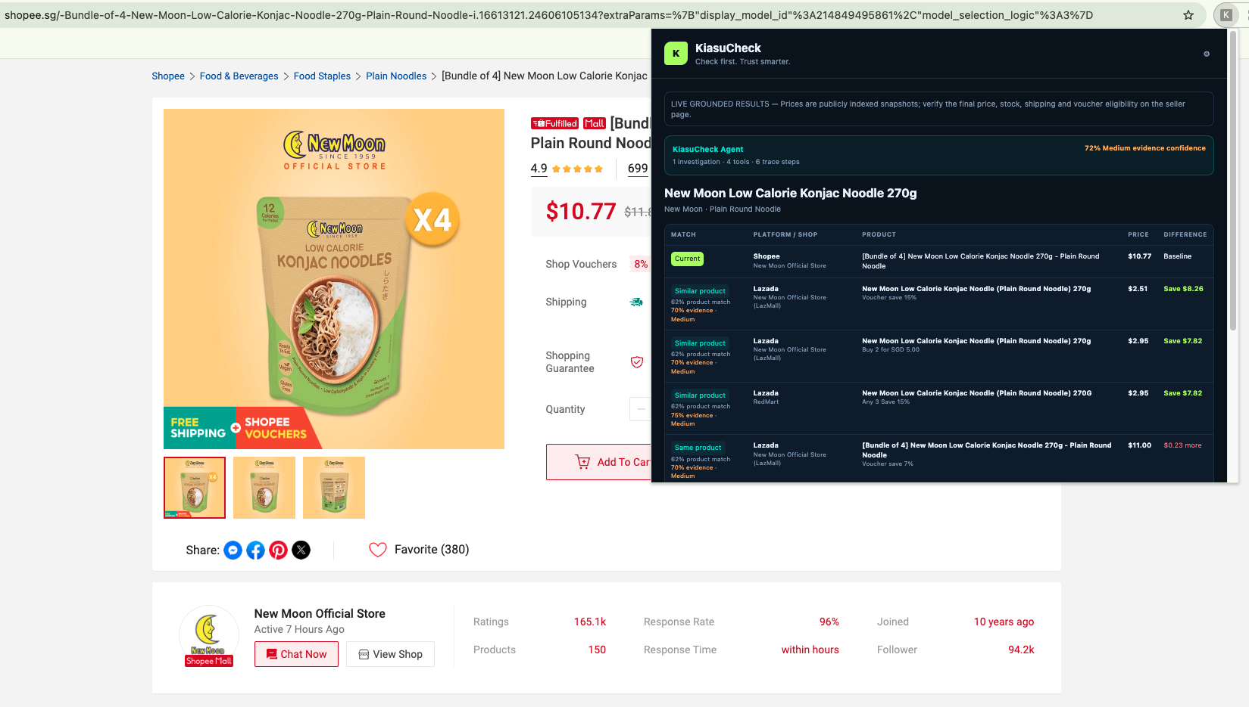
Working Prototype · Web App & Chrome Extension
Two ways to check: enter a product online or investigate directly from a shopping page.
Chrome Extension · Live on Shopee
Deployed Web Application

Slide 7
Architecture: From Browser to Agentic AI
Cloud Run connects the shopping experience to Gemini-led investigation and verified price results.
GEMINI · IDENTITY
Match merchant + item
USER EXPERIENCE
CLOUD RUN · API
RULE ENGINE · API
Web + Chrome extension
FastAPI + orchestrator
AI resolves aliases and variants
Validate + price check
Listing URL / screenshot → API
Receives request; runs agent loop
Reject mismatches; calculate gap
AGENT TOOL · SEARCH
Find platform listings
Grounded search + source evidence
RESPONSE → API → browser: price differences, source links and uncertainty

Slide 8
Agent Architecture · Inside KiasuCheck
One Cloud Run agent coordinates Gemini analysis, grounded search and deterministic verification.
ORCHESTRATOR
Plan checks · track evidence · decide whether to continue
↓
↓
↓
IDENTITY ANALYSIS
Gemini fingerprint + seller / product / bundle matching
SEARCH & EVIDENCE
Google Search grounding · candidate listings + source evidence
DETERMINISTIC VERIFICATION
Score identity · reject conflicts · calculate price differences
Optional retry: refine search terms when no supported candidate is found
RESULT BUILDER · Strong / possible / rejected matches · prices · sources · evidence confidence

Slide 9
Technology Stack: Built on Google Cloud
Services powering the web experience, agent reasoning and evidence-based results.
GENAI
FRESHNESS
RUNTIME
Gemini 3.5 Flash
Google Search grounding
Cloud Run
Vision + seller and product matching
Current public results + sources
Containerised mobile web + API
DELIVERY
EXPERIENCE
TRUST
Cloud Build
Chrome Manifest V3
Python match scorer
Repeatable source deployment
Active-page cross-platform price check
Auditable seller and SKU matching

Slide 10
Cost & Scalability · Lean by Design
Pay-per-use AI and serverless compute keep prototype operating costs controlled.
COMPUTE
AI
HACKATHON FOOTPRINT
Pay per request
Usage based
No database.
No crawler fleet.
No marketplace API.
Cloud Run scales to zero.
Extraction + grounded search.
STORAGE
CONTROL
Maximum three Cloud Run instances.
Near zero
Hard limits
No persistent shopper data.
5 MB upload cap + max instances.

Slide 11
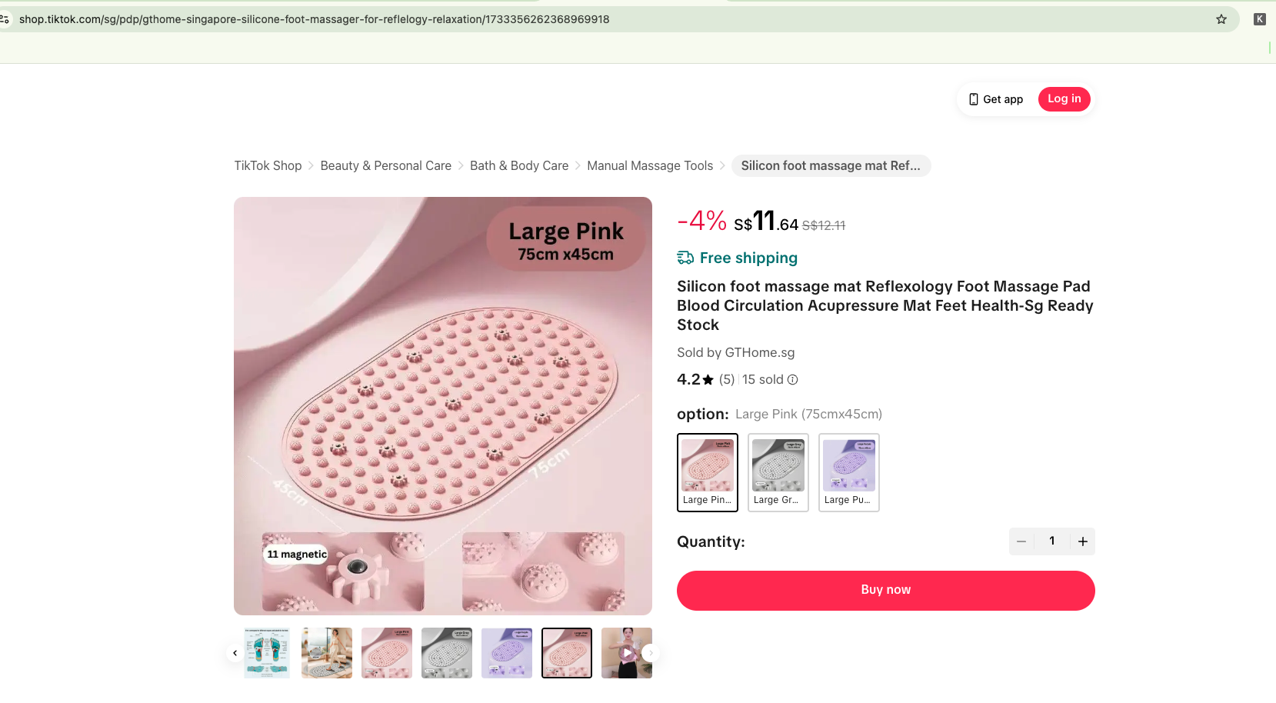
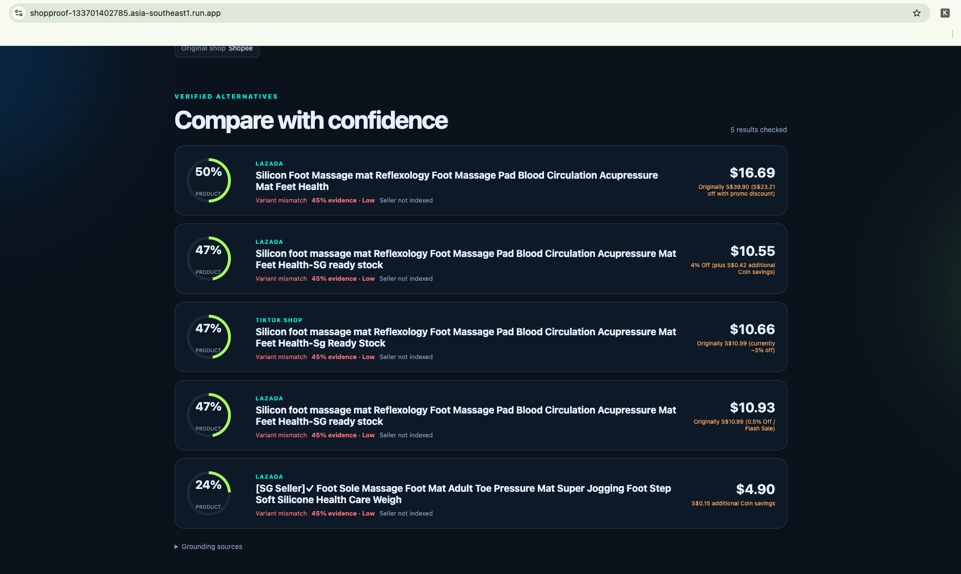
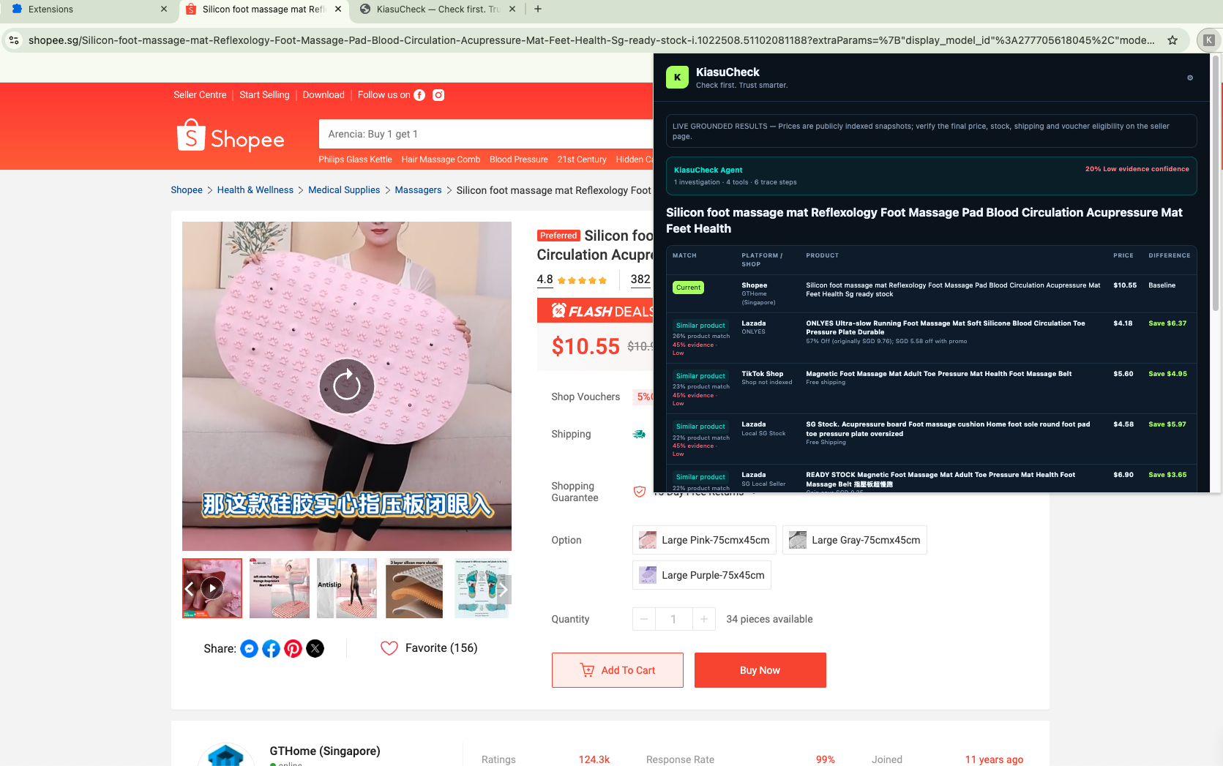
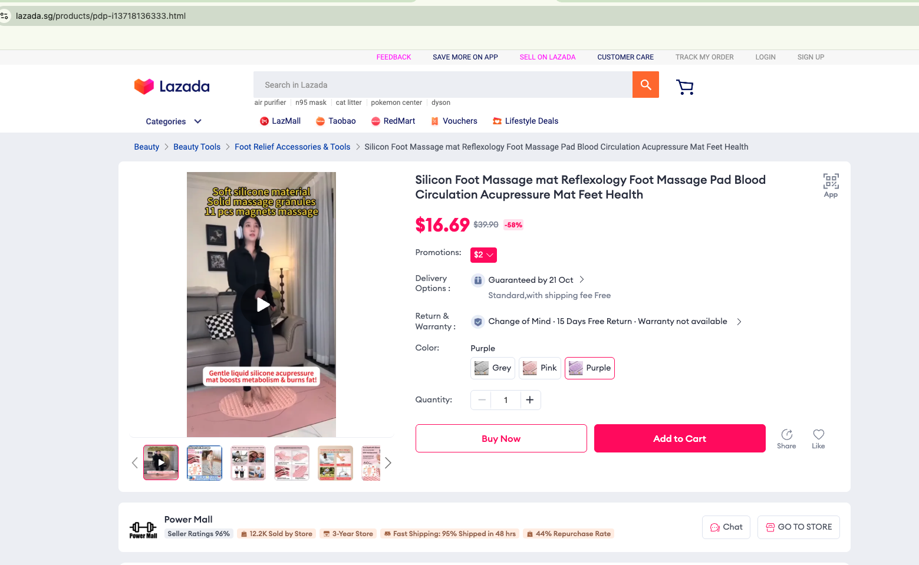
Agent Results · Evidence Beyond the Price Tag
Real Shopee investigation: distinguish bundle quantities, seller matches and comparable platform prices.

Slide 12
Measuring Agent Quality, Accuracy and Value
Measure the reliability of each investigation—not just whether the API responds.
IDENTITY ACCURACY
PRODUCT MATCHING
PRICE + EVIDENCE
Precision + recall
Correct match rate
Accuracy + traceability
Check same-merchant identification against labelled cases.
Test exact model, variant, bundle and warranty matches.
Compare shown prices with sources; flag missing costs.
END-TO-END SUCCESS
% of investigations returning correct, source-backed comparisons; track time and cost per check.

Slide 13
Product Roadmap · From Price Checks to Trust Checks
Start with shopping transparency; extend evidence-first verification to other online content.
NOW · SHOP CHECK
NEXT · TRUST CHECKS
SCALE · MEDIA CHECK
Working MVP
News + scam
AI image + video
Same-seller, same-product, or alternative product cross-platform comparison
Grounded evidence
Transparent uncertainty
Claim + source verification
Suspicious link signals
Evidence with uncertainty
Provenance signals
Manipulation detection
Cross-modal evidence

Slide 14
KiasuCheck: Explore the code, try the web app and use the extension
Hackathon Deliverables · Code, Cloud App & Extension
SOURCE CODE · GITHUB
github.com/sgirabin/2026-aibuildercup-hackathon
Agent implementation, browser extension, tests and deployment instructions.
DEPLOYED WEB APP
BROWSER EXTENSION
Google Cloud Run
Chrome extension / plugin
shopproof-133701402785.asia-southeast1.run.app
In-page price check connected to the Cloud Run API.

Slide 15


